Slide 1
Teoría de las Comunicaciones
Address Resolution
Address Resolution Protocol (ARP)
Proxy ARP
Reverse Address Resolution Protocol (RARP)
IP Maximum Transmission Unit (MTU) and Fragmentation
IP Datagram Next-Hop Routing
Internet Control Message Protocol (ICMP)
Ping - Traceroute
http://www.tcpipguide.com/

Slide 2
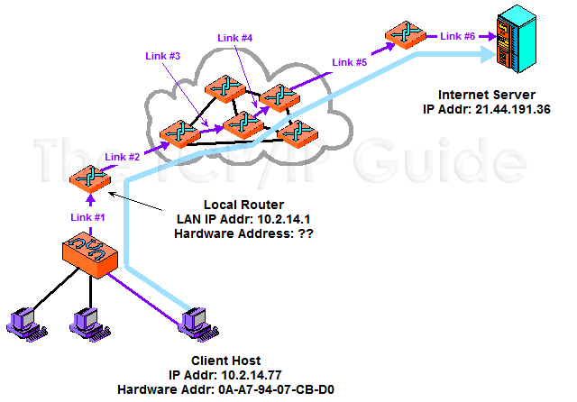
Why Address Resolution Is Necessary

Slide 3
Why Address Resolution Is Necessary
In this example, a client on the local network is accessing a server somewhere on the Internet. Logically, this connection can be made “directly” between the client and server, but in reality it is a sequence of physical links at layer two. In this case there are six such links, most of them between routers that lie between the client and server. At each step the decision of where to send the data is made based on a layer three address, but the actual transmission must be performed using the layer two address of the next intended recipient in the route.

Slide 4
Address resolution
Key Concept: Address resolution is required because internetworked devices communicate logically using layer three addresses, but the actual transmissions between devices take place using layer two (hardware) addresses.

Slide 5
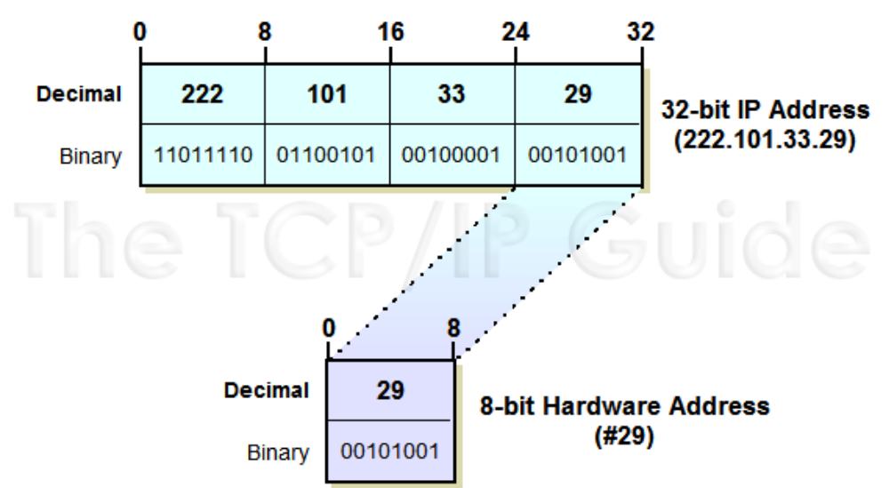
Address Resolution Through Direct Mapping

Slide 6
Address Resolution Through Direct Mapping
Key Concept: When the layer two address is smaller than the layer three address, it is possible to define a direct mapping between them, so that the hardware address can be determined directly from the network layer address. This makes address resolution extremely simple, but reduces flexibility in how addresses are assigned.

Slide 7
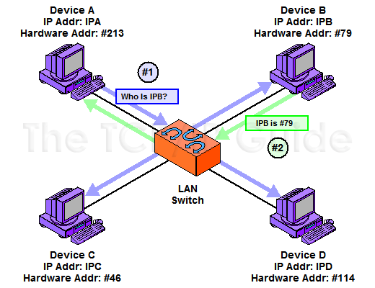
Dynamic Address Resolution

Slide 8
Address Resolution Protocol (ARP)
Device A needs to send data to Device B but knows only its IP address (“IPB”), and not its hardware address. A broadcasts a request asking to be sent the hardware address of the device using the IP address “IPB”. B responds back to A directly with the hardware address

Slide 9
Dynamic address resolution
Key Concept: Dynamic address resolution is usually implemented using a special protocol. A device that knows only the network layer address of another device can use this protocol to request the other device’s hardware address.

Slide 10
ARP
Key Concept: ARP was developed to facilitate dynamic address resolution between IP and Ethernet, and can now be used on other layer two technologies as well. It works by allowing an IP device to send a broadcast on the local network, requesting that another device on the same local network respond with its hardware address.

Slide 11
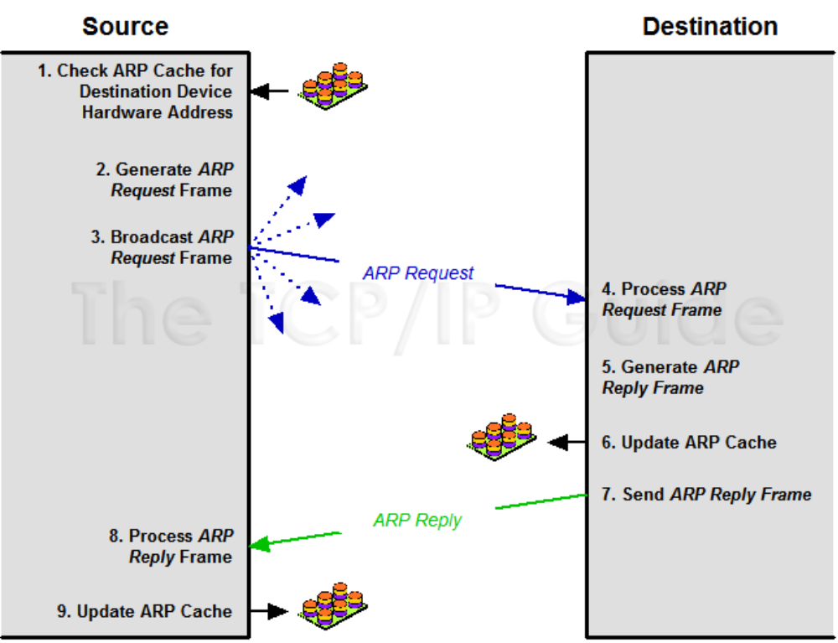
Address Resolution Protocol (ARP) Transaction Process

Slide 12
Address Resolution Protocol (ARP) Transaction Process
This diagram shows the sequence of steps followed in a typical ARP transaction, as well as the message exchanges between a source and destination device, and cache checking and update functions.

Slide 13
ARP
Key Concept: ARP is a relatively simple request/reply protocol. The source device broadcasts an ARP Request looking for a particular device based on its IP address. That device responds with its hardware address in an ARP Reply message.

Slide 14
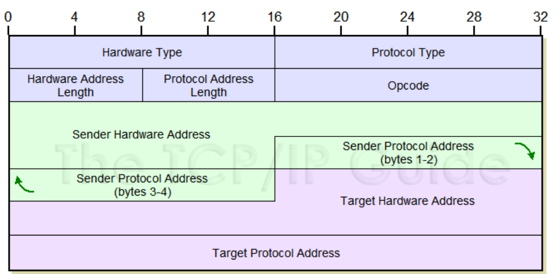
Address Resolution Protocol (ARP) Message Format

Slide 15
Address Resolution Protocol (ARP) Message Format
The ARP message format is designed to accommodate layer two and layer three addresses of various sizes. This diagram shows the most common implementation, which uses 32 bits for the layer three (“Protocol”) addresses, and 48 bits for the layer two hardware addresses. These numbers of course correspond to the address sizes of the Internet Protocol version 4 and IEEE 802 MAC addresses, used by Ethernet

Slide 16
Proxy ARP
In contrast to the normal situation, in some networks there might be two physical network segments connected by a router that are in the same IP network or subnetwork. In other words, device A and device B might be on different networks at the data link layer level, but on the same IP network or subnet. When this happens, A and B will each think the other is on the local network when they look to send IP datagrams. In this situation, suppose that A wants to send a datagram to B. It doesn't have B's hardware address in the cache, so it begins an address resolution. When it broadcasts the ARP Request message to get B's hardware address, however, it will quickly run into a problem: B is in fact not on A's local network. The router between them will not pass A's broadcast onto B's part of the network, because routers don't pass hardware-layer broadcasts. B will never get the request and thus A will not get a reply containing B’s hardware address.

Slide 17
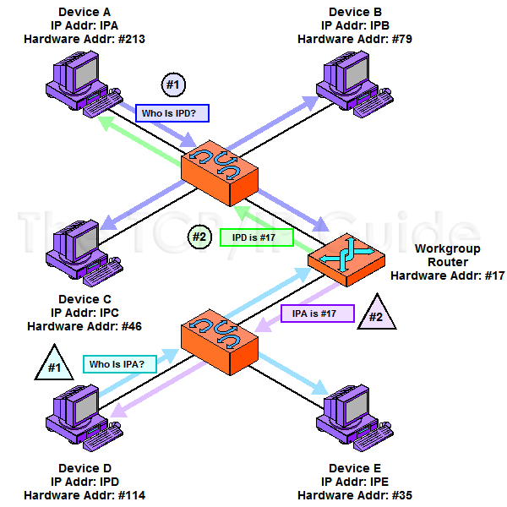
ARP Proxy Operation

Slide 18
ARP Proxy Operation
In this small internetwork, a single router connects two LANs that are on the same IP network or subnet. The router will not pass ARP broadcasts, but has been configured to act as an ARP proxy. In this example, device A and device D are each trying to send an IP datagram to the other, and so each broadcasts an ARP Request. The router responds to the request sent by Device A as if it were Device D, giving to A its own hardware address (without propagating Device A’s broadcast.) It will forward the message sent by A to D on D’s network. Similarly, it responds to Device D as if it were Device A, giving its own address, then forwarding what D sends to it over to the network where A is located.

Slide 19
Proxy ARP
Key Concept: Since ARP relies on broadcasts for address resolution, and broadcasts are not propagated beyond a physical network, ARP cannot function between devices on different physical networks. When such operation is required, a device, such as a router, can be configured as an ARP proxy to respond to ARP requests on the behalf of a device on a different network.

Slide 20
Reverse Address Resolution Protocol (RARP)
The first method devised to address the bootstrapping problem in TCP/IP was the backwards use of ARP I mentioned above. This technique was formalized in RFC 903, A Reverse Address Resolution Protocol (RARP), published in 1984. Where ARP allows device A to say “I am device A and I have device B's IP address, device B please tell me your hardware address”, RARP is used by device A to say “I am device A and I am sending this broadcast using my hardware address, can someone please tell me my IP address?”.

Slide 21
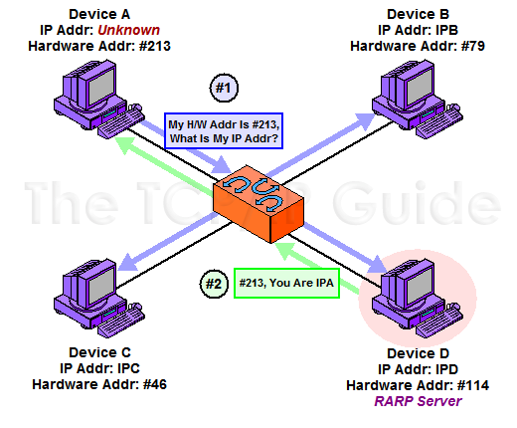
Operation of the Reverse Address Resolution Protocol (RARP)

Slide 22
Operation of the Reverse Address Resolution Protocol (RARP)
RARP, as the name suggests, works like ARP but in reverse, so this diagram is similar. Here, instead of Device A providing the IP address of another device and asking for its hardware address, it is providing its own hardware address and asking for an IP address it can use. The answer, in this case, is provided by Device D, which is serving as an RARP server for this network.

Slide 23
RARP
Key Concept: The Reverse Address Resolution Protocol (RARP) is the earliest and simplest protocol designed to allow a device to obtain an IP address for use on a TCP/IP network. It is based directly on ARP and works in basically the same way, but in reverse: a device sends a request containing its hardware address and a device set up as an RARP server responds back with the device’s assigned IP address.

Slide 24
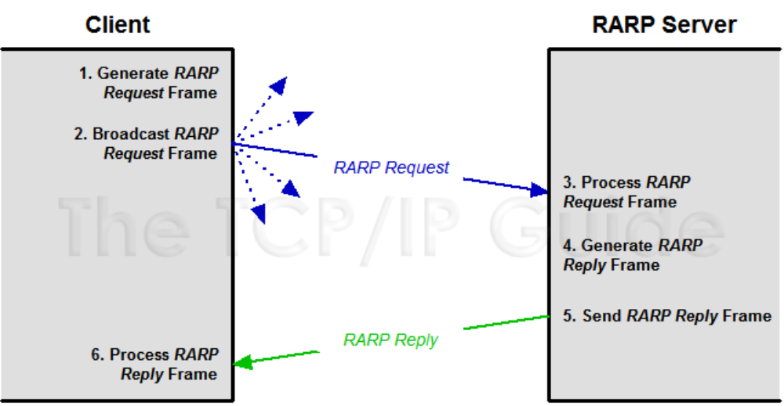
Reverse Address Resolution Protocol (RARP) Operation

Slide 25
RARP
Today, the importance of host configuration has increased since the early 1980s. Many organizations assign IP addresses dynamically even for hosts that have disk storage, because of the many advantages this provides in administration and efficient use of address space. For this reason, RARP has been replaced by two more capable technologies that operate at higher layers in the TCP/IP protocol stack: BOOTP and DHCP.

Slide 26
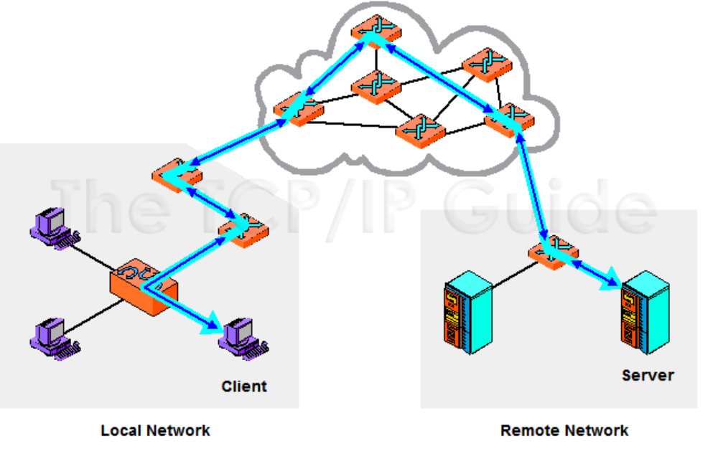
The Main Function of IP: Internetwork Datagram Delivery

Slide 27
The Main Function of IP: Internetwork Datagram Delivery
The fundamental job of the Internet Protocol is the delivery of datagrams from one device to another over an internetwork. In this generic example, a distant client and server communicate with each other by passing IP datagrams over a series of interconnected networks.

Slide 28
IP
Key Concept: While the Internet Protocol has many functions and characteristics, it can be boiled down to one primary purpose: the delivery of datagrams across an internetwork of connected networks.

Slide 29
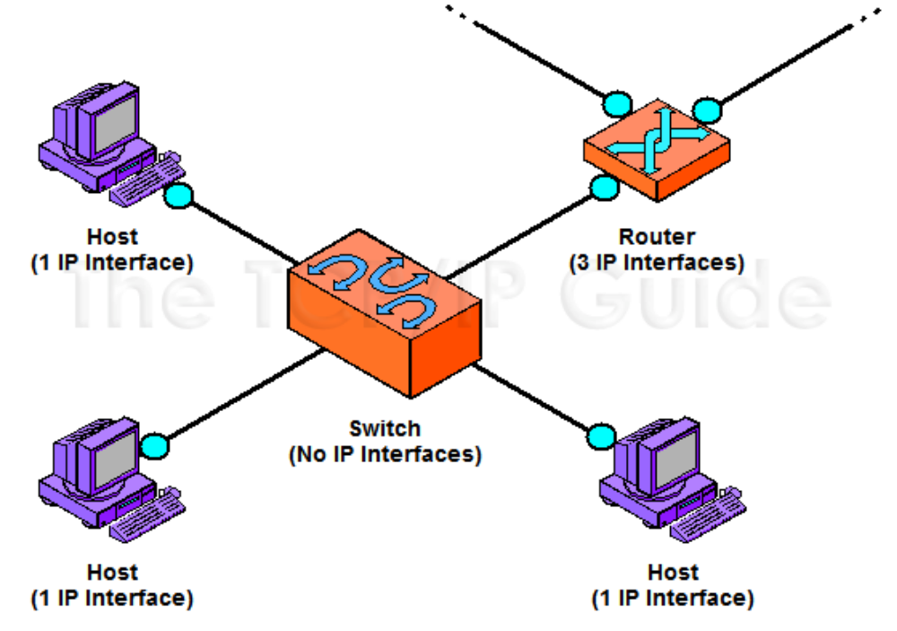
IP Interfaces for Common Network Devices

Slide 30
IP Interfaces for Common Network Devices
This illustration shows the IP interfaces of a few common of LAN devices as small cyan circles. Each regular host has one interface, while the router that serves this LAN has three, since it connects to three different networks. Note that the LAN switch has no IP interfaces; it connects the hosts and router at layer two. Also see Figure 59, which shows the IP interfaces of devices in a more complex configuration.

Slide 31
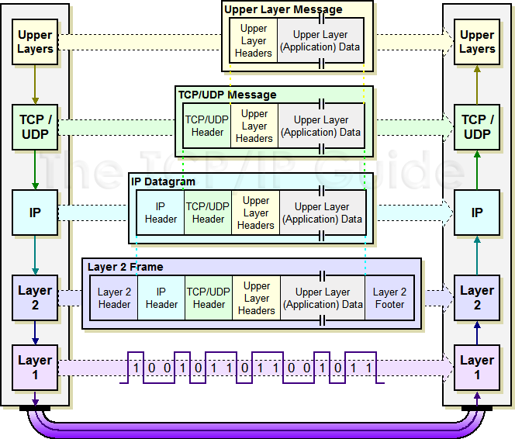
IP Datagram Encapsulation

Slide 32
IP Datagram Encapsulation
Very similar drawing for the OSI Reference Model as a whole, showing specifically how data encapsulation is accomplished in TCP/IP. As you can see, an upper layer message is packaged into a TCP or UDP message. This then becomes the payload of an IP datagram, which is shown here simply with one header (things can get a bit more complex than this.) The IP datagram is then passed down to layer 2 where it is in turn encapsulated into some sort of LAN, WAN or WLAN frame, then converted to bits and transmitted at the physical layer.

Slide 33
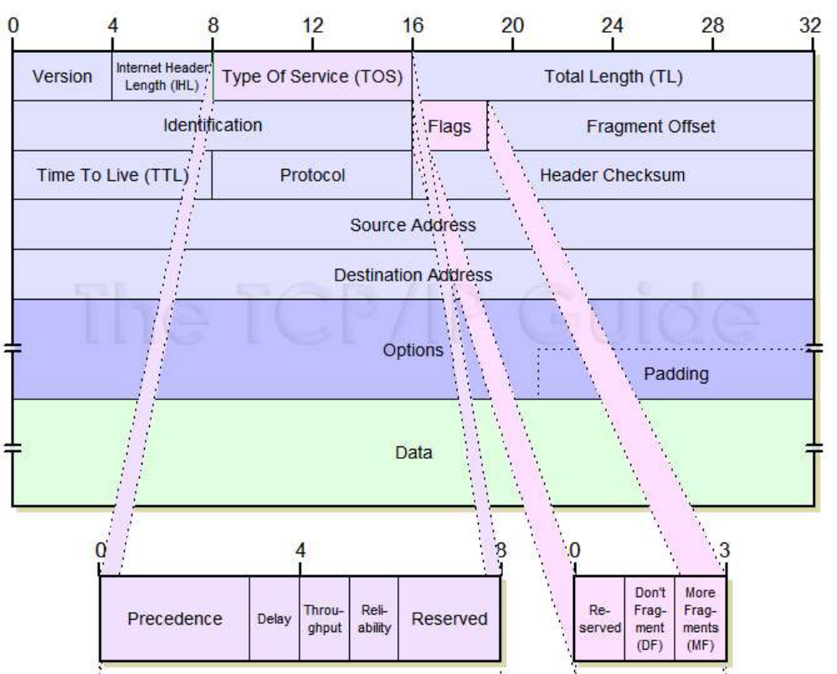
Internet Protocol Version 4 (IPv4) Datagram Format

Slide 34
Internet Protocol Version 4 (IPv4) Datagram Format
This diagram shows graphically the all-important IPv4 datagram format. The first 20 bytes are the fixed IP header, followed by an optional Options section, and a variable-length Data area. Note that the Type Of Service field is shown as originally defined in the IPv4 standard.

Slide 35
IP
Key Concept: Each IPv4 datagram has a 20-byte mandatory header, and may also include one or more options. Each option has its own field format, and most are variable in size.

Slide 36
IP
Key Concept: The size of the largest IP datagram that can be transmitted over a physical network is called that network’s maximum transmission unit (MTU). If a datagram is passed from a network with a high MTU to one with a low MTU, it must be fragmented to fit the network with the smaller MTU.

Slide 37
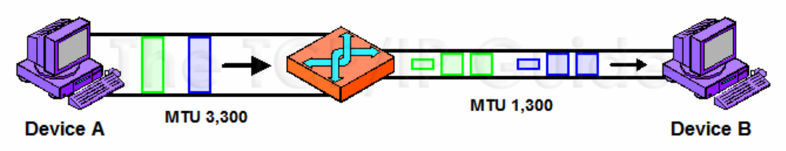
IP Maximum Transmission Unit (MTU) and Fragmentation

Slide 38
IP Maximum Transmission Unit (MTU) and Fragmentation
In this simple example, Device A is sending to Device B over a small internetwork consisting of one router and two physical links. The link from A to the router has an MTU of 3,300 bytes, but from the router to B it is only 1,300 bytes. Thus, any IP datagrams over 1,300 bytes will need to be fragmented.

Slide 39
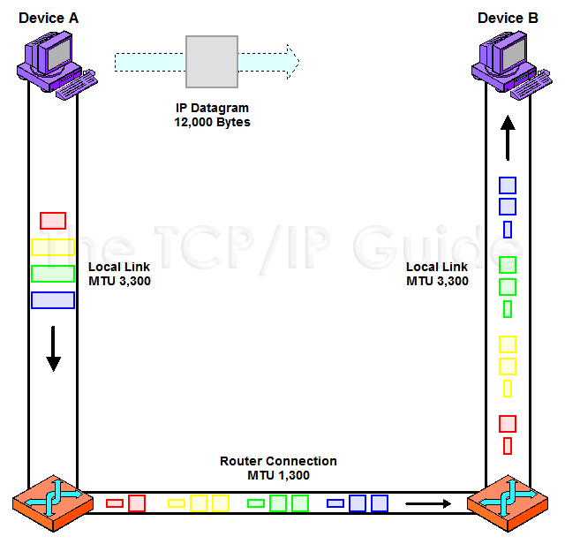
IPv4 Datagram Fragmentation

Slide 40
IPv4 Datagram Fragmentation
This example shows illustrates a two-step fragmentation of a large IP datagram. The boxes represent datagrams or datagram fragments and are shown to scale. The original datagram is 12,000 bytes in size, represented by the large gray box. To transmit this data over the first local link, Device A splits it into four fragments, shown at left in four primary colors. The first router must fragment each of these into smaller fragments to send them over the 1,300-byte MTU link, as shown on the bottom. Note that the second router does not reassemble the 1,300-byte fragments, even though its link to Device B has an MTU of 3,300 bytes.

Slide 41
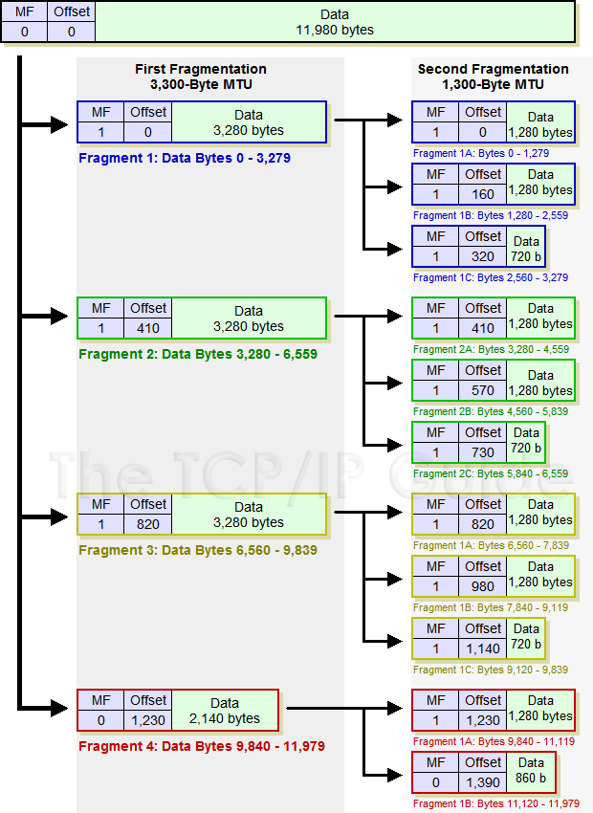
IPv4 Datagram Fragmentation Process

Slide 42
IPv4 Datagram Fragmentation Process
In this diagram, the MF and Fragment Offset fields of each fragment are shown for reference. The Data fields are shown to scale (the length of each is proportional to the number of bytes in the fragment.)

Slide 43
IP Fragmentation
Key Concept: When an MTU requirement forces a datagram to be fragmented, it is split into several smaller IP datagrams, each containing part of the original. The header of the original datagram is changed into the header of the first fragment, and new headers are created for the other fragments. Each is set to the same Identification value to mark them as part of the same original datagram. The Fragment Offset of each is set to the location where the fragment belongs in the original. The More Fragments field is set to 1 for all fragments but the last, to let the recipient know when it has received all the fragments.

Slide 44
IP Fragmentation
Key Concept: In IPv4, fragmentation can be performed by a router between the source and destination of an IP datagram, but reassembly is only done by the destination device.

Slide 45
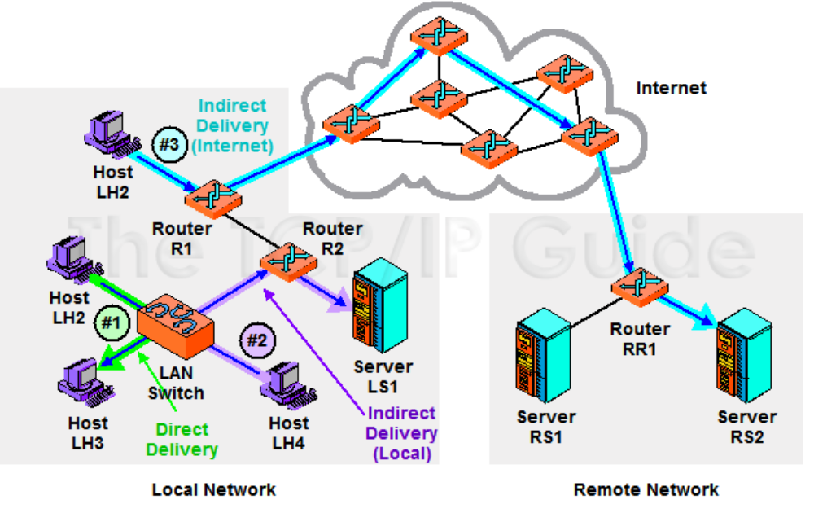
Direct and Indirect (Routed) Delivery of IP Datagrams

Slide 46
Direct and Indirect (Routed) Delivery of IP Datagrams
This diagram shows three examples of IP datagram delivery. The first transmission (highlighted in green) shows a direct delivery between two devices on the local network. The second (purple) shows indirect delivery within the local network, between a client and server separated by a router. The third shows a more distant indirect delivery, between a client on the local network and a server across the Internet.

Slide 47
Direct and Indirect (Routed) Delivery of IP Datagrams
Key Concept: The delivery of IP datagrams is divided into two categories: direct and indirect. Direct delivery is possible when two devices are on the same physical network. When they are not, indirect delivery, more commonly called routing, is required to get the datagrams from source to destination. A device can tell which type of delivery is required by looking at the IP address of the destination, in conjunction with supplemental information such as the subnet mask that tells the device what network or subnet it is on.

Slide 48
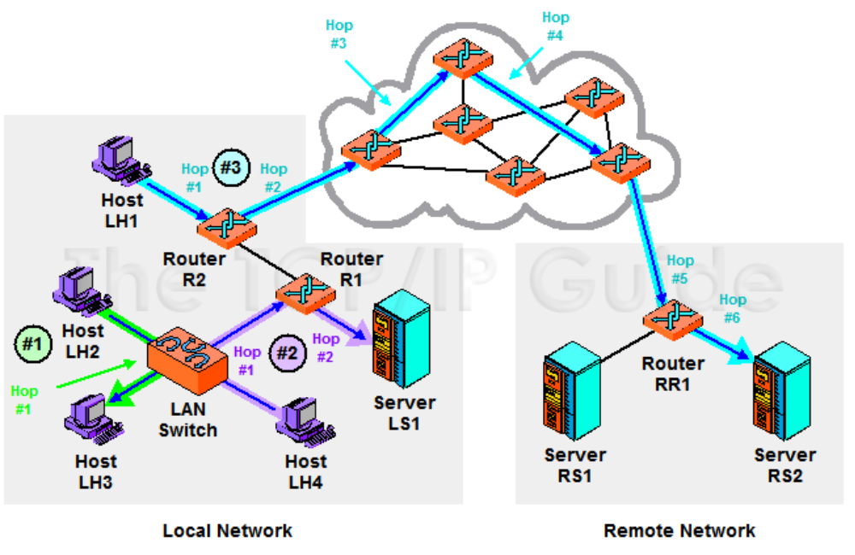
IP Datagram Next-Hop Routing

Slide 49
IP Datagram Next-Hop Routing
This time I have explicitly shown the hops taken by each of the three sample transmissions. The direct delivery of the first (green) transmission has only one hop (remember that the switch doesn’t count because it is invisible at layer three). The local indirect delivery passes through one router, so it has two hops. The Internet delivery in this case has six hops; actual Internet routes can be much longer.

Slide 50
IP Datagram Next-Hop Routing
Key Concept: Indirect delivery of IP datagrams is accomplished using a process called next-hop routing, where each message is handed from one router to the next until it reaches the network of the destination. The main advantage of this is that each router needs only to know which neighboring router should be the next recipient of a given datagram, rather than needing to know the exact route to every destination network.

Slide 51
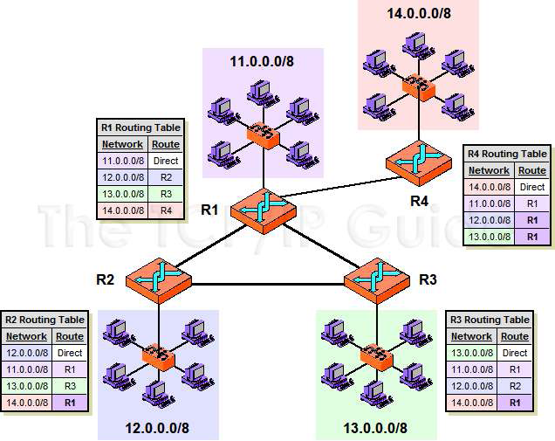
IP Routing and Routing Tables

Slide 52
IP Routing and Routing Tables
This diagram shows a small, simple internetwork consisting of four LANs each served by a router. The routing table for each lists the router to which datagrams for each destination network should be sent, and is color coded to match the colors of the networks. Notice that due to the “triangle”, each of R1, R2 and R3 can send to each other. However, R2 and R3 must send through R1 to deliver to R4, and R4 must use R1 to reach either of the others.

Slide 53
Internet Control Message Protocol (ICMP)
Key Concept: In TCP/IP, diagnostic, test and error-reporting functions at the internet/network layer are performed by the Internet Control Message Protocol (ICMP), which is like the Internet Protocol’s “administrative assistant”. The original version, now called ICMPv4, is used with IPv4, and the newer ICMPv6 with IPv6.

Slide 54
ICMP
Key Concept: ICMP is not like most other TCP/IP protocols in that it does not perform a specific task. It defines a mechanism by which various control messages can be transmitted and received to implement a variety of functions.

Slide 55
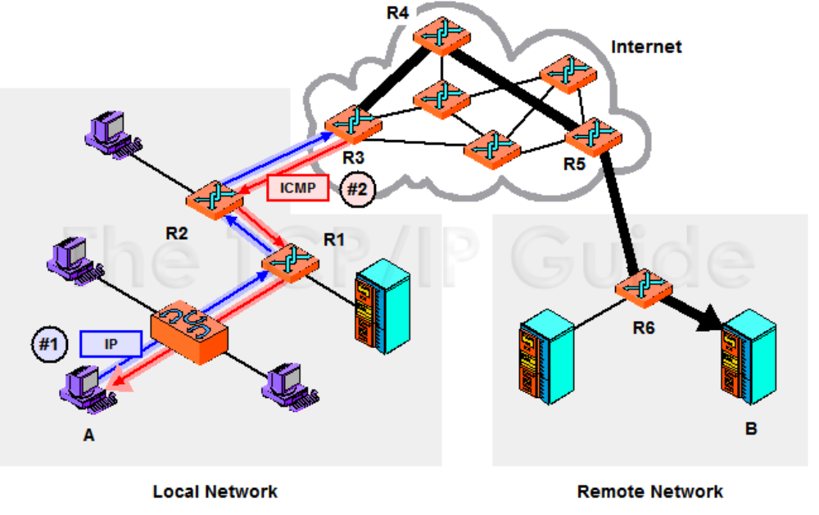
ICMP General Operation

Slide 56
ICMP General Operation
A typical use of ICMP is to provide a feedback mechanism when an IP message is sent. In this example, device A is trying to send an IP datagram to device B. However, when it gets to router R3 a problem of some sort is detected that causes the datagram to be dropped. R3 sends an ICMP message back to A to tell it that something happened, hopefully with enough information to let A correct the problem, if possible. R3 can only send the ICMP message back to A, not to R2 or R1.

Slide 57
ICMP
Key Concept: ICMP error-reporting messages sent in response to a problem seen in an IP datagram can only be sent back to the originating device. Intermediate devices cannot be the recipient of an ICMP message because their addresses are normally not carried in the IP datagram’s header.

Slide 58
ICMP
ICMP messages are divided into two general categories: error messages that are used to report problem conditions, and informational messages that are used for diagnostics, testing and other purposes.

Slide 59
ICMP
Key Concept: A total of 256 different possible message types can be defined for each of ICMPv4 and ICMPv6. The Type field that appears in the header of each message specifies the kind of ICMP message. In ICMPv4 there is no relationship between Type value and message type; in ICMPv6 error messages have a Type value of 0 to 127, informational messages 128 to 255.

Slide 60
ICMP
Key Concept: A device receiving an ICMP message is not required to take action unless a protocol using a message type dictates a specific response to a particular message type. In particular, devices are not mandated to perform any specific task when receiving an ICMP error message.

Slide 61
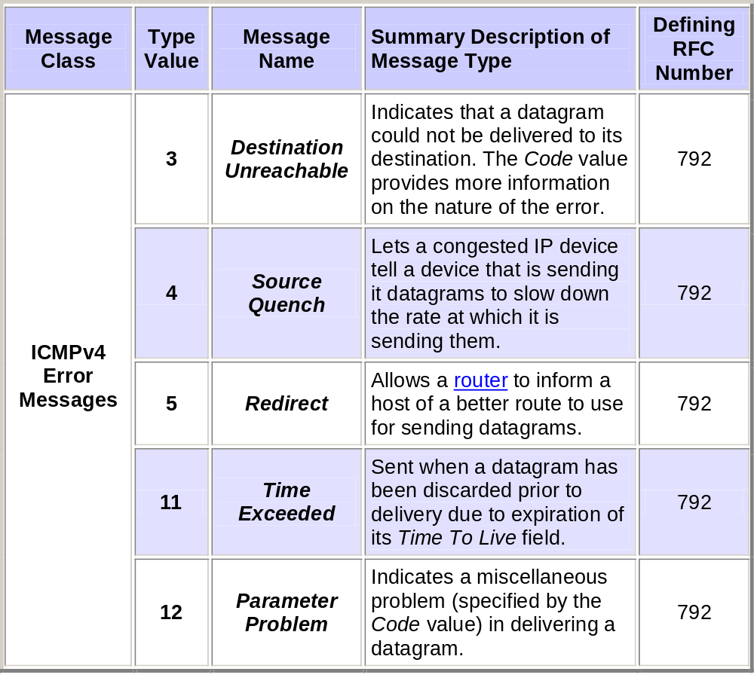
ICMP

Slide 62
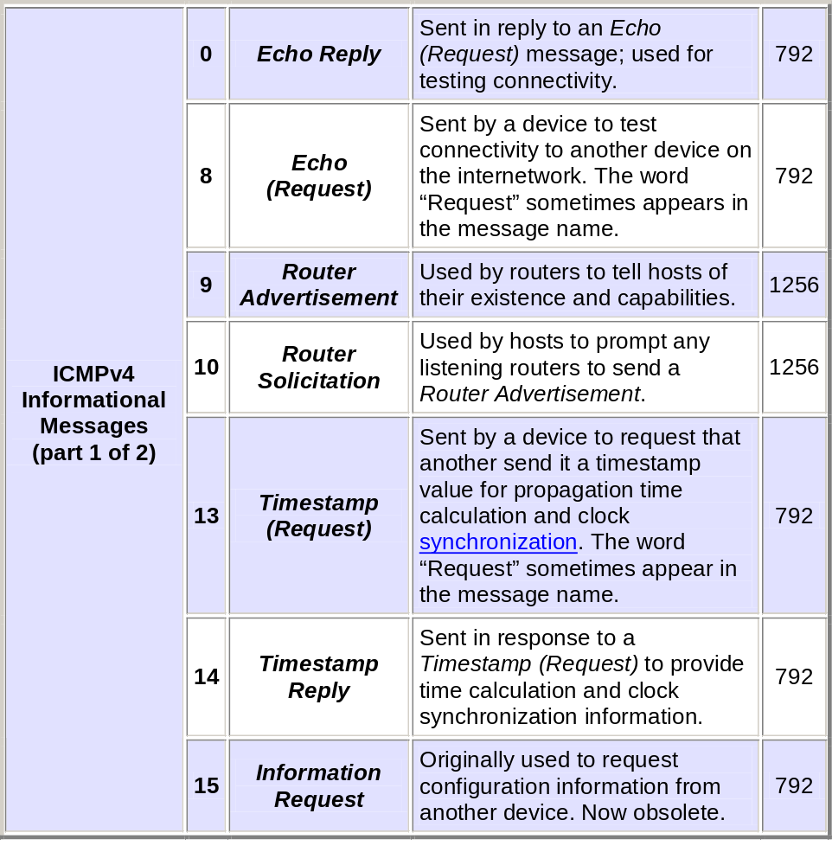
ICMP

Slide 63
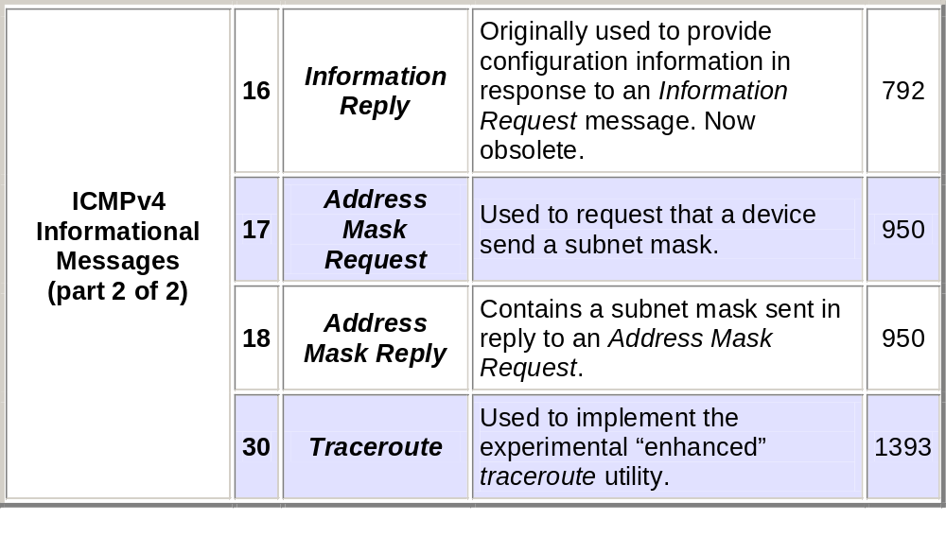
ICMP

Slide 64
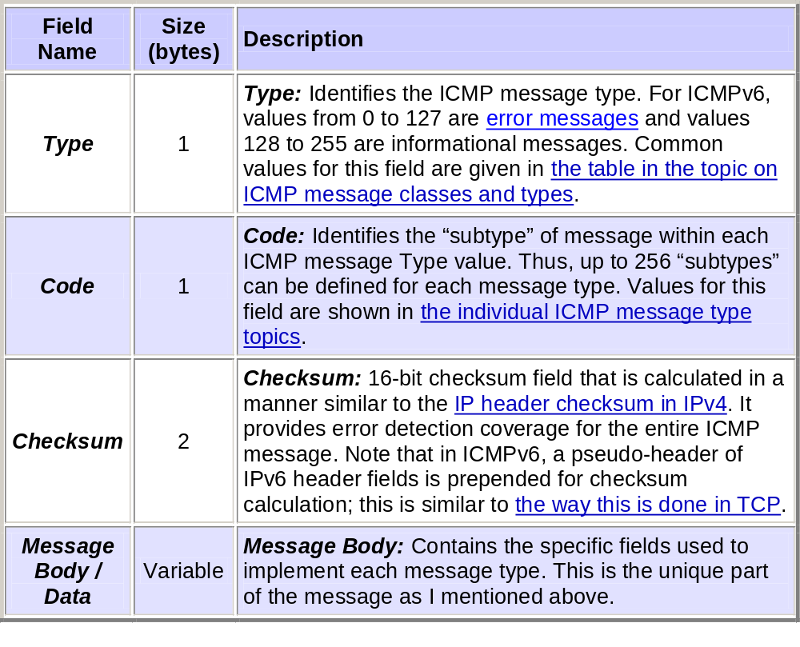
ICMP Common Message Format

Slide 65
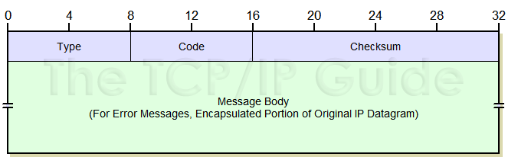
ICMP Common Message Format

Slide 66
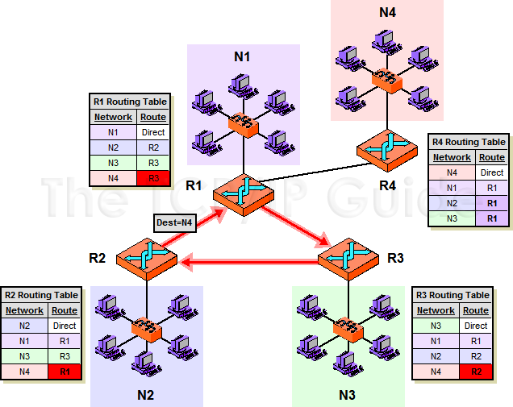
An Example of A Router Loop

Slide 67
ICMPv6 Time Exceeded Messages
This diagram shows a simple internetwork consisting of four networks, each of which is served by a router. In this case the routing tables have been set up incorrectly. R1 thinks that it needs to route any traffic intended for network N4 to R3; R3 thinks it goes to R2; and R2 thinks it goes back to R1. This means that when any device tries to send to N4, the datagram will circle this “triangle” until its Hop Limit is reached, at which point an ICMPv6 Time Exceeded message will be generated.

Slide 68
ICMPv6 Time Exceeded Messages
Key Concept: ICMPv4 Time Exceeded messages are sent in two different “timerelated” circumstances. The first is if a datagram’s Time To Live (TTL) field is reduced to zero, causing it to expire and the datagram to be dropped. The second is when all the pieces of a fragmented message are not received before the expiration of the recipient’s reassembly timer.

Slide 69
Applications of Time Exceeded Messages
As an ICMP error message type, ICMP Time Exceeded messages are usually sent in response to the two conditions described above (TTL or reassembly timer expiration). Generally, Time To Live expiration messages are generated by routers as they try to route a datagram, while reassembly violations are indicated by end hosts. However, there is actually a very clever application of these messages that has nothing to do with reporting errors at all.

Slide 70
Applications of Time Exceeded Messages
The TCP/IP traceroute (or tracert) utility is used to show the sequence of devices over which a datagram is passed on a particular route between a source and destination, as well as the amount of time it takes for a datagram to reach each hop in that route. This utility was originally implemented using Time Exceeded messages by sending datagrams with successively higher TTL values. First, a “dummy” datagram is sent with a TTL value of 1, causing the first hop in the route to discard the datagram and send back an ICMP Time Exceeded; the time elapsed for this could be measured. Then, a second datagram is sent with a TTL value of 2, causing the second device in the route to report back a Time Exceeded, and so on. By continuing to increase the TTL value we can get reports back from each hop in the route.

Slide 71
TCP/IP Communication Verification Utility (ping)
Key Concept: The TCP/IP ping utility is used to verify the ability of two devices on a TCP/IP internetwork to communicate. It operates by having one device send ICMP Echo (Request) messages to another, which responds with Echo Reply messages. The program can be helpful in diagnosing a number of connectivity issues, especially if it is used to test the ability to communicate with other devices in different locations. It also allows the average round-trip delay to exchange messages with another device to be estimated.

Slide 72
Verifying Communication Using the ping Utility
D:\aa>ping www.pcguide.com
Pinging pcguide.com [209.68.14.80] with 32 bytes of data:
Reply from 209.68.14.80: bytes=32 time=582ms TTL=56
Reply from 209.68.14.80: bytes=32 time=601ms TTL=56
Request timed out.
Reply from 209.68.14.80: bytes=32 time=583ms TTL=56
Ping statistics for 209.68.14.80:
Packets: Sent = 4, Received = 3, Lost = 1 (25% loss),
Approximate round trip times in milli-seconds:
Minimum = 582ms, Maximum = 601ms, Average = 588ms

Slide 73
TCP/IP Route Tracing Utility (traceroute)
Like the ping utility, traceroute is implemented using ICMP messages. However, unlike ping, traceroute was originally not designed to use a special ICMP message type intended exclusively for route tracing. Instead, it makes clever use of the IP and ICMP features that are designed to prevent routing problems.
Recall that the IP datagram format includes a Time To Live (TTL) field. This field is set to the maximum number of times that a datagram may be forwarded before it must be discarded; it exists to prevent datagrams from circling an internetwork endlessly. If a datagram must be discarded due to expiration of the TTL field, the device that discards it is supposed to send back to the device that send that datagram an ICMP Time Exceeded message.

Slide 74
TCP/IP Route Tracing Utility (traceroute)
Suppose we have device A and device B, which are separated by routers R1 and R2—three hops total. If you do a traceroute from device A to device B, here’s what happens:
  The traceroute utility sends a dummy UDP message (sometimes called a probe) to a port number that is intentionally selected to be invalid. The TTL field of the IP datagram is set to 1. When R1 receives the message, it decrements the field, which will make its value 0. That router discards the probe and sends an ICMP Time Exceeded message back to device A.
  Device A then sends a second UDP message with the TTL field set to 2. This time, R1 reduces the TTL value to 1 and sends it to R2, which reduces the TTL field to 0 and sends a Time Exceeded message back to A.
  Device A sends a third UDP message, with the TTL field set to 3. This time, the message will pass through both routers and be received by device B. However, since the port number was invalid, the message is rejected by device B, which sends back a Destination Unreachable message to device A.

Slide 75
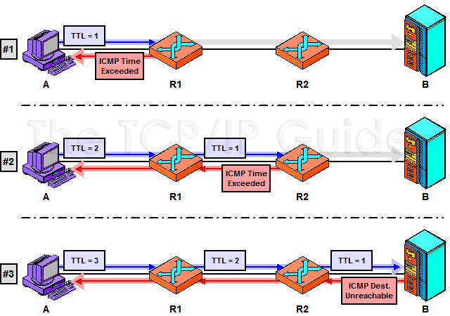
Operation of the traceroute/tracert Utility

Slide 76
Operation of the traceroute/tracert Utility
The traceroute utility identifies the devices in a route by forcing them to report back failures to route datagrams with parameters intentionally set to invalid values. The first message sent by device A here has a Time To Live (TTL) value of 1, which will cause R1 it to drop it and send an ICMP Time Exceeded message back to A. The second one has a TTL value of 2, so it will be dropped and reported by R2. The third will pass both routers and get to the destination host, B, but since the message is deliberately chosen with a bogus port number, this will cause an ICMP Destination Unreachable to be returned. These error messages identify the sequence of devices in the route between devices A and B.

Slide 77
TCP/IP Route Tracing Utility (traceroute)
Key Concept: The traceroute utility takes the idea behind ping one step further, allowing not only communication between two devices to be checked, but also letting an administrator see a list of all the intermediate devices between the pair. It works by having the initiating host send a series of test datagrams with TTL values that cause each to expire sequentially at each device on the route. The traceroute program also shows how much time it takes to communicate with each device between the sending host and a destination device.

Slide 78
Route Tracing Using the traceroute Utility
traceroute -q2 www.pcguide.com
traceroute to www.pcguide.com (209.68.14.80), 40 hops max, 40 byte packets
1 cisco0fe0-0-1.bf.sover.net (209.198.87.10) 1.223 ms 1.143 ms
2 cisco1fe0.bf.sover.net (209.198.87.12) 1.265 ms 1.117 ms
3 cisco0a5-0-102.wnskvtao.sover.net (216.114.153.170) 8.004 ms 7.270 ms
4 207.136.212.234 (207.136.212.234) 7.163 ms 7.601 ms
5 sl-gw18-nyc-2-0.sprintlink.net (144.232.228.145) 15.948 ms 20.931 ms
6 sl-bb21-nyc-12-1.sprintlink.net (144.232.13.162) 21.578 ms 16.324 ms
7 sl-bb27-pen-12-0.sprintlink.net (144.232.20.97) 18.296 ms *
8 sl-bb24-pen-15-0.sprintlink.net (144.232.16.81) 18.041 ms 18.338 ms
9 sl-bb26-rly-0-0.sprintlink.net (144.232.20.111) 20.259 ms 21.648 ms
10 sl-bb20-rly-12-0.sprintlink.net (144.232.7.249) 132.302 ms 37.825 ms
11 sl-gw9-rly-8-0.sprintlink.net (144.232.14.22) 23.085 ms 20.082 ms
12 sl-exped4-1-0.sprintlink.net (144.232.248.126) 43.374 ms 42.274 ms
13 * *
14 pcguide.com (209.68.14.80) 41.310 ms 49.455 ms

Slide 79
TCP/IP Route Tracing Utility (traceroute)
Note: Not all traceroute utility implementations use the technique described above. Microsoft’s tracert works not by sending UDP packets but rather ICMP Echo messages with increasing TTL values. It knows it has reached the final host when it gets back an Echo Reply message. A special ICMP Traceroute message was also developed in 1993, which was intended to improve the efficiency of traceroute by eliminating the need to send many UDP messages for each route tracing. Despite its technical advantages, since it was introduced long after TCP/IP was widely deployed, it never became a formal Internet standard and is not seen as often as the traditional method.

Slide 80
Referencia
The TCP/IP Guide
Charles M. Kozierok
  http://www.tcpipguide.com/

